Slide 1
Social Media Revolution
http://www.youtube.com/watch?v=lFZ0z5Fm-Ng&feature=related

Slide 2
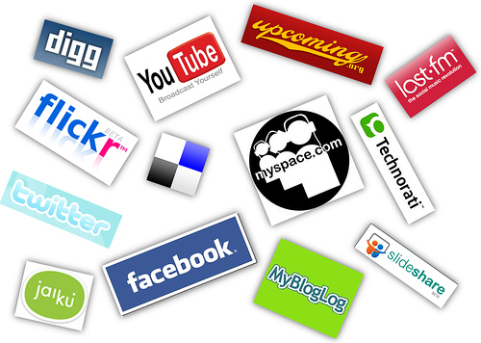

Slide 3
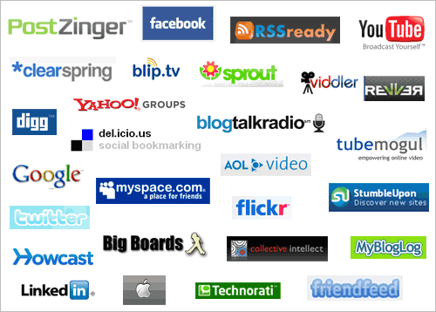

Slide 4
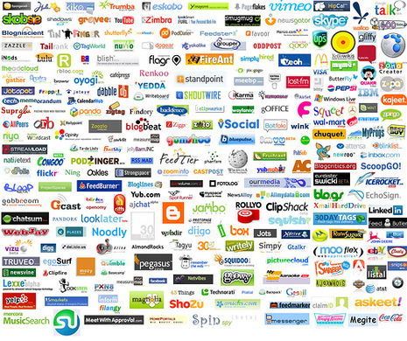

Slide 5
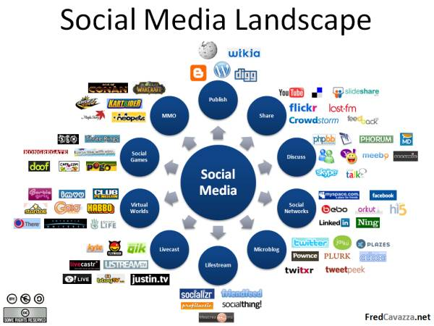

Slide 6
Benefits of Social Media
FREE!
Increased visibility and familiarity
Engaged and interested audiences
Increased referrals through 3rd party validation
Creating new relationships

Slide 7
Sharing
Provide a Share tool
Promote the outlets you use
www.RiverMarket.info

Slide 8
Facebook
Uses
  Publicizing your name, message and services
  Blog or Discussion Board
  Event calendar
  Post photos and videos
  http://www.facebook.com/ExperienceLR

Slide 9
Twitter
Uses
  Call to action
  Immediate information
  Reminders
  Frequent, short messages
  http://twitter.com/Rivermarket

Slide 10
Videos & Podcasts
Holds people’s attention
YouTube
No videos, no problem
CGI Communications - http://www.elocallink.tv/zmag/arhospitality/
Animoto.com - http://animoto.com/play/umgZRQ17RBOyI1A1l9TKXA

Slide 11
Flickr
Photo Sharing
Pictures say it all
Create Photo Albums
http://www.flickr.com/photos/lrcvb/sets

Slide 12
Additional Tools
LinkedIn
Blogs
Mobile Applications

Slide 13
Questions?

